Slide 1

TACOMA ECO CLEANING COMPANY LIMITED
Small Details, Big Difference.
Commercial Cleaning | Residential Cleaning | Office Sanitation | Pest Control & Fumigation | Deep Cleaning Services

Slide 2

About Tacoma.
Tacoma Eco Cleaning Company Limited is a Kenyan-owned cleaning and environmental hygiene company providing professional residential, commercial, institutional, and specialized cleaning services. We exist to protect future generations by creating safe, clean, and sustainable environments through environmentally responsible practices, precision, and exceptional customer service.
Our commitment extends beyond cleaning to environmental conservation and community impact, preserving natural resources while promoting healthier, safer, and more productive spaces for the communities we serve.
Through continuous staff development and adherence to industry best practices, we deliver innovative, reliable, and sustainable solutions that create lasting value for our clients, communities, and the environment.

Slide 3

Our Purpose
We exist to protect future generations by creating safe, clean, and sustainable environments. Through responsible cleaning practices, environmental conservation, and community-centered initiatives, we preserve natural resources, improve the quality of life in the communities we serve, and create a lasting positive impact.
Our mission
To deliver exceptional cleaning and sanitation services that create safe, healthy, and sustainable environments while promoting environmental conservation and community well-being.
Our Vision
To become Kenya’s most trusted eco-conscious cleaning and hygiene solutions provider, leading the way in environmental preservation, community improvement, and sustainable impact for future generations.

Slide 4


Our Values
Integrity
Acting with honesty, ethics, and professionalism.
Accountability
Taking responsibility for our actions and results.
Transparency
Promoting openness and clear communication.
Trust and Respect
Building strong relationships through reliability and mutual respect.
Continuous Improvement
Embracing learning, innovation, and best practices.
Environmental Stewardship
Protecting the environment through sustainable practices.

Slide 5

Our services
Residential Cleaning Services
Routine home cleaning
Deep cleaning
Move-in/move-out cleaning
Apartment cleaning
Post-renovation cleaning
Specialized Cleaning Services
Post-construction cleaning
High-level cleaning
Carpet cleaning
Upholstery cleaning
Window cleaning
Pest Control & Fumigation
Residential fumigation
Commercial pest management
Rodent control
Insect management
Preventive treatment programmes
Commercial Cleaning Services
Office cleaning
Corporate facilities cleaning
Retail and showroom cleaning
Hospitality cleaning
Shared workspace maintenance

Slide 6

The roots of our name
Why Tacoma?
The name Tacoma is inspired by an indigenous term associated with a majestic glacier-capped mountain that sustains life through the water and resources it provides to surrounding communities. This symbolism reflects our purpose: preserving the environment, improving the communities we serve, and creating a lasting positive impact.
Just as mountains nurture and sustain life, Tacoma is committed to creating cleaner, healthier, and more sustainable environments while empowering communities through responsible environmental stewardship and service excellence. We believe that cleanliness extends beyond physical spaces—it contributes to healthier lifestyles, stronger communities, and a more sustainable future.
Our Commitment
Preserve the environment through responsible cleaning practices.
Improve living and working environments for communities.
Create meaningful and lasting social impact.
Promote sustainable operations and resource conservation.
Deliver solutions that enhance well-being and environmental responsibility.
Inspired by Kenya's rich natural heritage—from its mountains and forests to its rivers, savannahs, and coastlines—we remain committed to protecting the resources that sustain life while delivering exceptional cleaning solutions for generations to come.
.

Slide 7

Engineering Precision
Our service delivery is guided by structured systems, including:
Standard operating procedures
Cleaning checklists
Inspection protocols
Staff training programmes
Quality assurance reviews
This ensures every service is:
Consistent
Measurable
Professional
Reliable
Sustainable

Slide 8


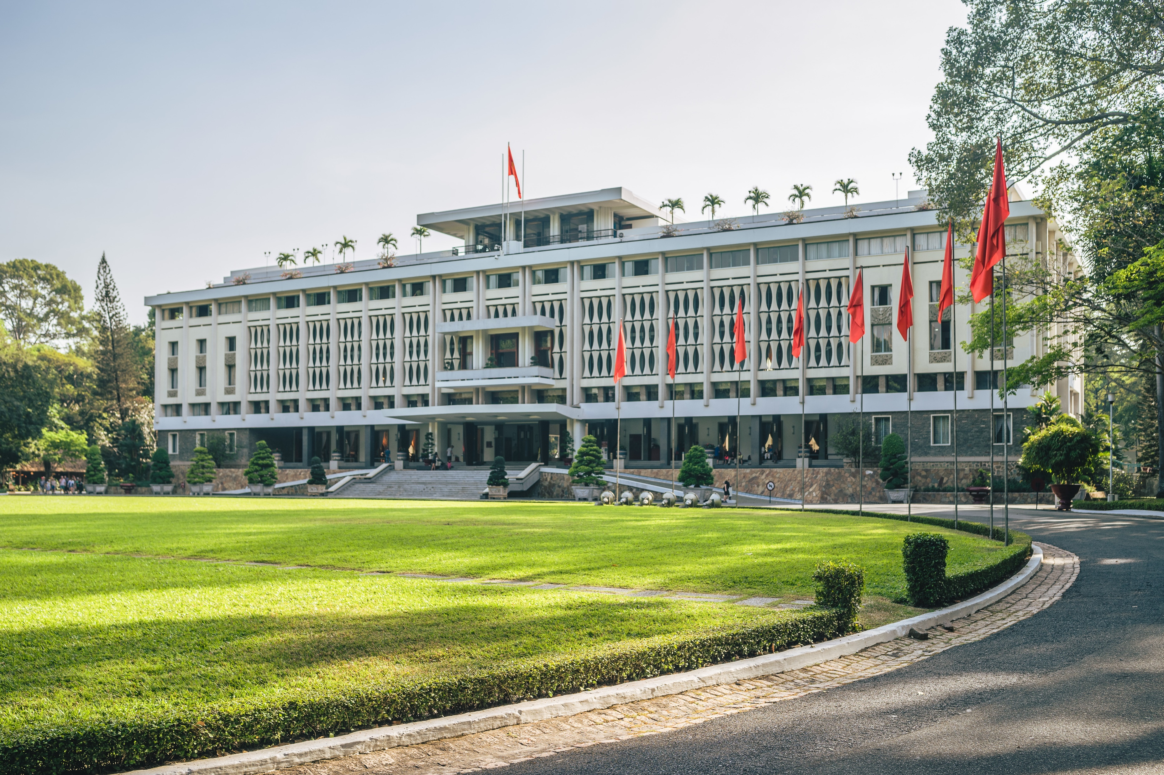
Target market
Tacoma serves three key market segments:
Residential Clients
Homeowners
Tenants
Apartments
Gated communities
Commercial Clients
Offices
Shopping centers
Hotels
Restaurants
Real estate developments
Institutional Clients
Schools
Universities
Hospitals
NGOs
Government facilities
Religious institutions

Slide 9


Step 1 – Consultation & Site Assessment
We evaluate:
Property size
Cleaning requirements
Frequency
Special requests
Our work flow.
Step 2 – Service Planning
A customized cleaning plan is developed.
Step 3 – Service Delivery
Our trained teams execute cleaning using approved procedures and equipment.
Step 4 – Quality Inspection
A supervisor verifies completion using Tacoma's Precision Inspection Checklist.
Step 5 – Client Sign-Off
Clients review completed work and provide feedback.

Slide 10

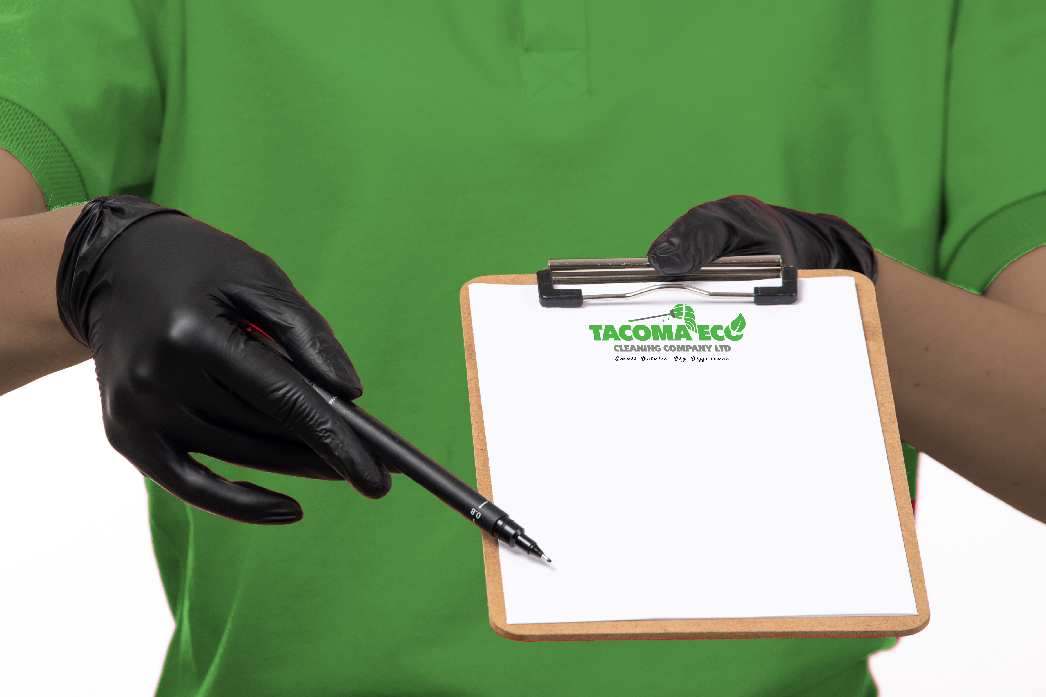
The Tacoma precision inspection system
Our quality assurance process ensures consistency and accountability.
Inspection Areas
Washrooms
Toilet sanitization
Mirror polishing
Floor disinfection
Final Audit
High-touch points
Air quality assessment
Customer satisfaction review
Offices & Living Spaces
Dusting
Surface sanitization
Floor treatment
Furniture cleaning
Kitchens
Appliance cleaning
Surface degreasing
Sink sanitization

Slide 11

OUR UNIQUE SELLING PREPOSITION
Why Clients Choose Tacoma
Eco-conscious operations focused on environmental preservation.
Community-centered approach that promotes improvement and positive impact.
Continuously trained and skilled personnel.
Structured quality control systems.
Flexible service packages.
Reliable scheduling and service delivery.
Customer-centric culture.
Transparent communication and reporting.
Integrity in our engagement.

Slide 12

Brand promise & customer experience
Safe, clean, and sustainable solutions that protect people and future generations.
Environmentally responsible practices that support conservation and sustainability.
Professionally trained and supervised teams.
Structured quality assurance systems.
Consistent, measurable service standards.
Positive impact on the communities we serve.
Exceptional customer experiences
we
Our goal is not simply to clean spaces but to become a trusted partner in facilities and hygiene.

Slide 13
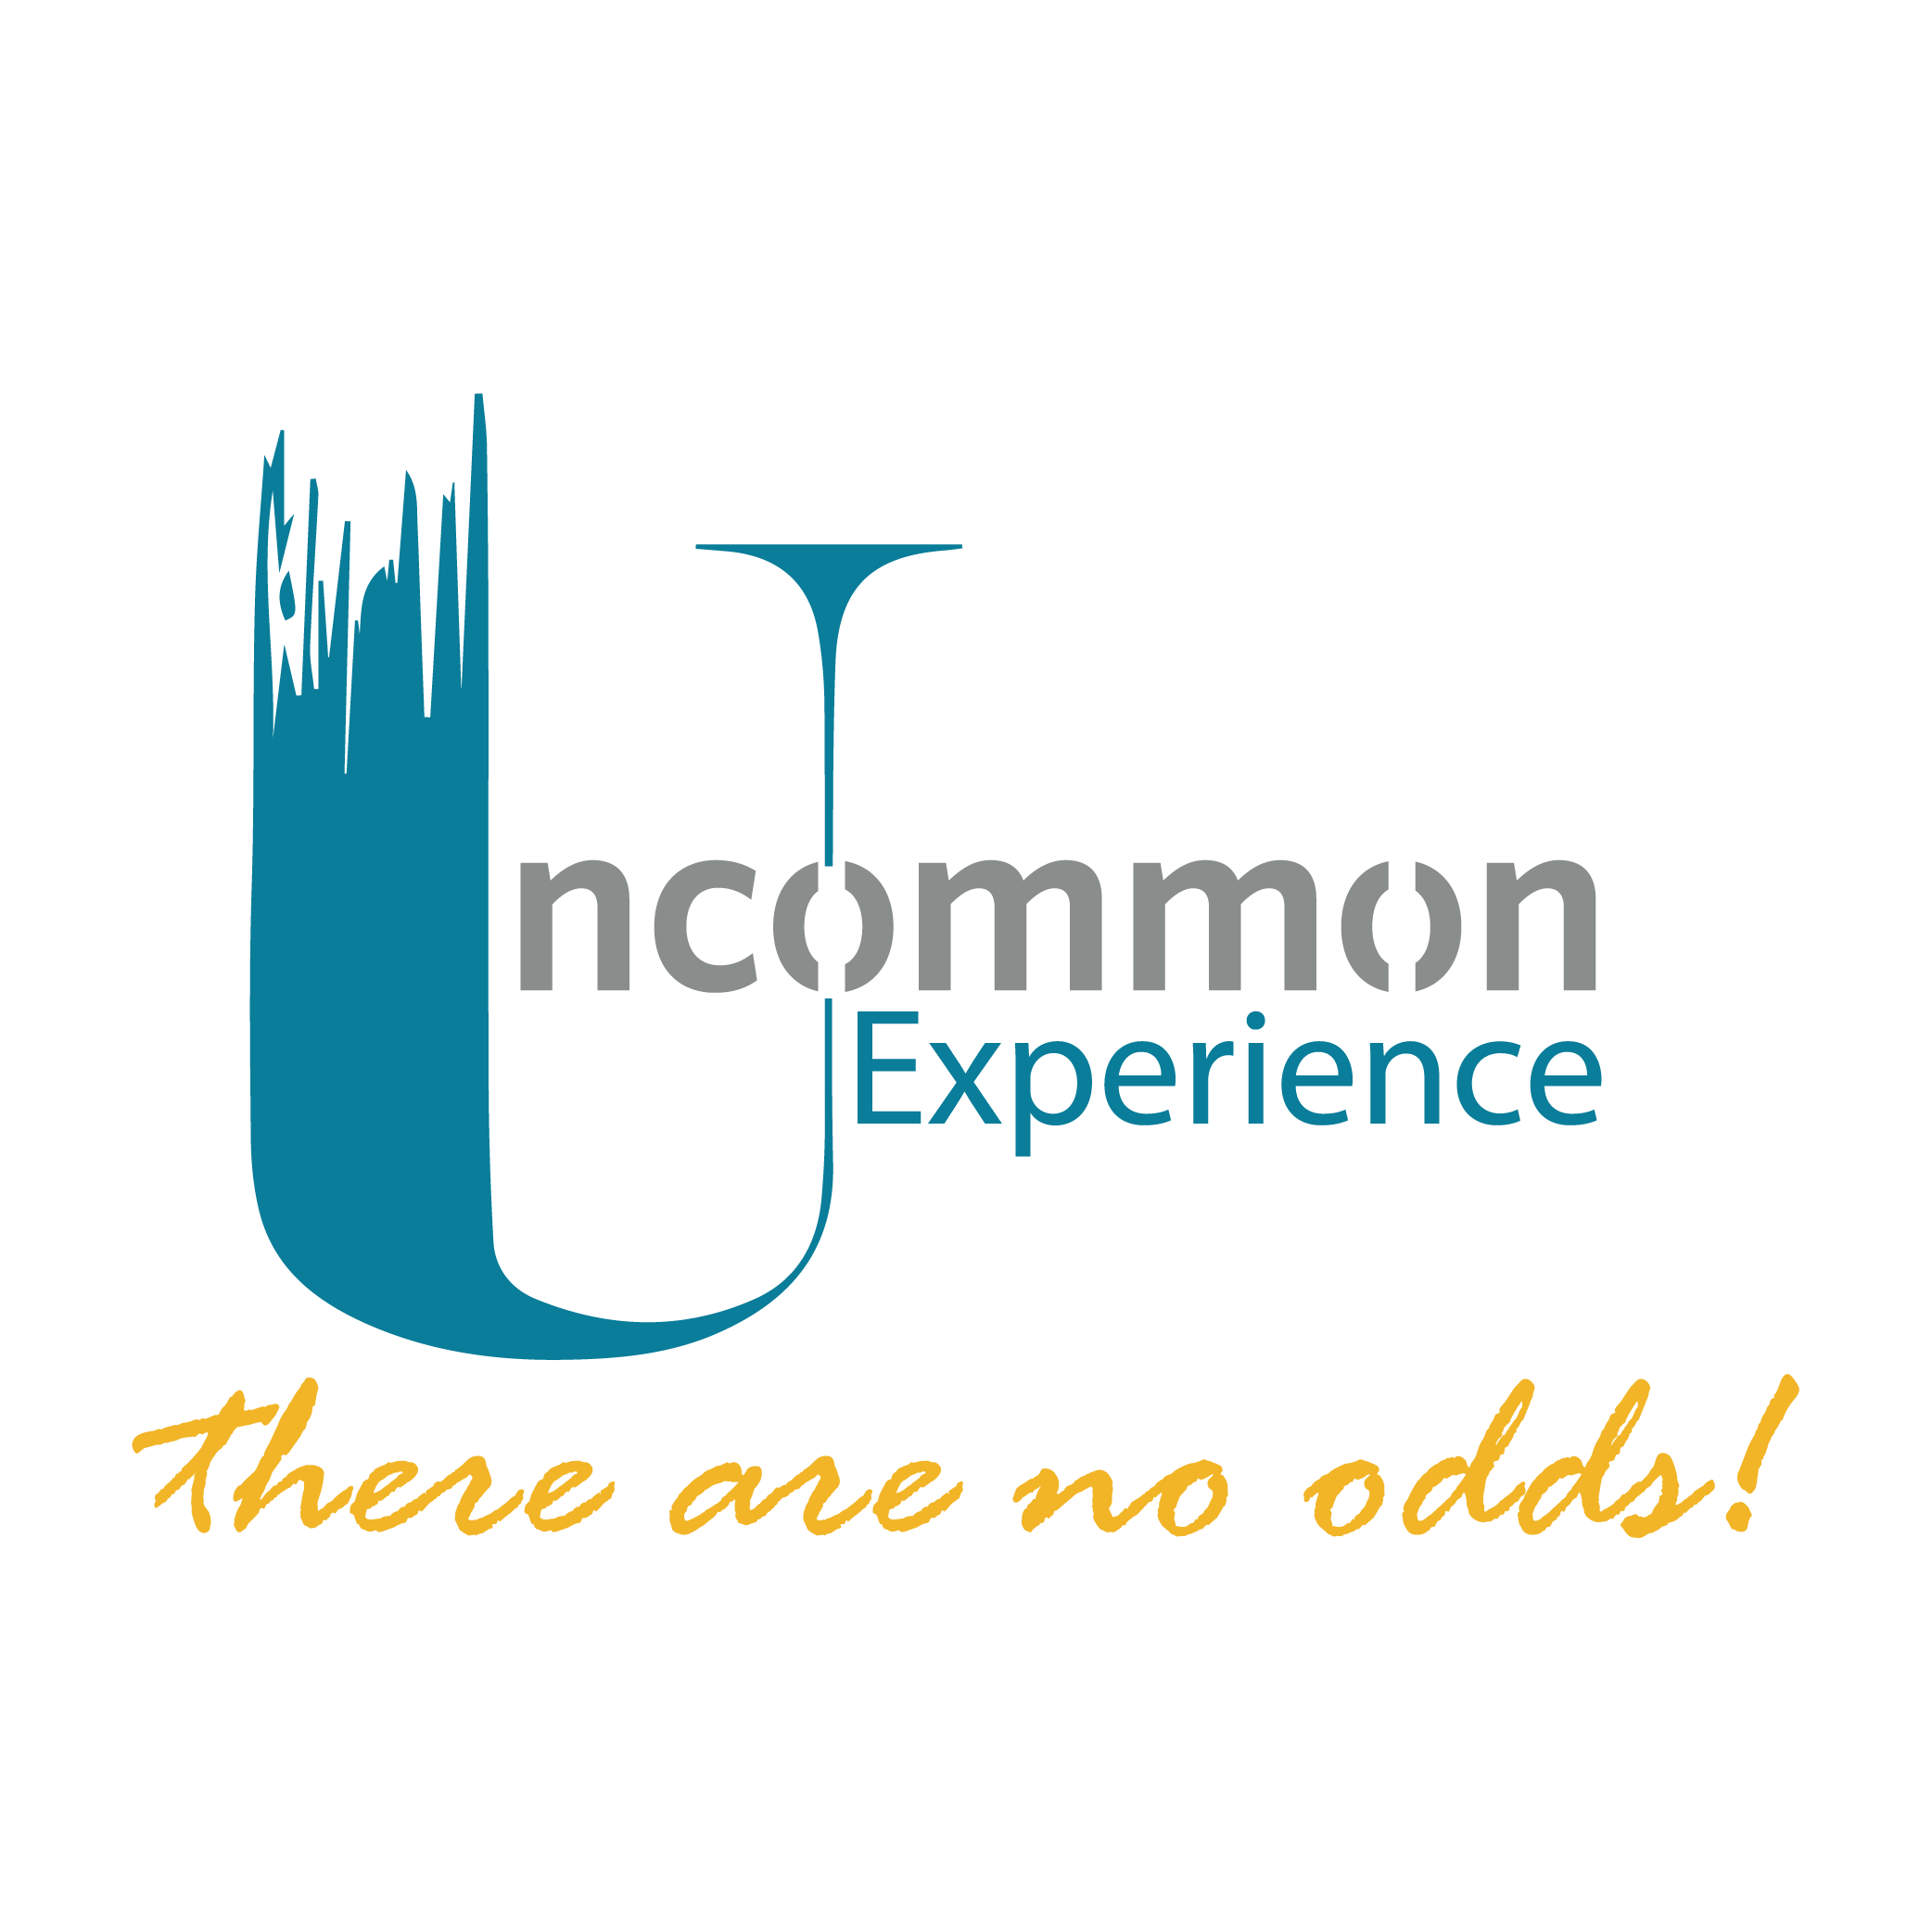



Our Clients

Slide 14

Precision for Your Space
Every project is delivered with meticulous attention to detail, structured quality assurance, and a commitment to creating safe, clean, and healthy environments.
Preservation for Our Planet
Every cleaning decision is guided by environmental conservation, sustainable practices, and responsible resource use to help protect future generations.
Positive Impact for Our Communities
We work alongside our clients and communities to improve living and working environments, creating lasting social and environmental impact through responsible business practices.
WHY
Tacoma?

Slide 15
Tacoma Eco Cleaning Company Limited.
Nature-Inspired. Precision-Driven.
📍 Nairobi, Kenya
📞 +254 XXX XXX XXX
📧 hello@tacomaecocleaning.co.ke
🌐 www.tacomaecocleaning.co.ke
Where Environmental Responsibility Meets Operational Excellence.
CONTACT US

